Slide 1


DESIGN 1
Lesson 3: What Is HTML? Exploring the Web Around Us
Ms. Abboud | Grade 9 - Design 1 | Term 1, Week 1

Slide 2
Learning Objectives
WALT - We Are Learning To
WILF - What I'm Looking For
To explain the purpose of HTML.
To identify the key components of a webpage.
I can define HTML in my own words.
I can identify at least 3 webpage components on a real site.
I can explain why HTML matters for communicating with an audience.

Slide 3
Academic Vocabulary
HTML
Browser
The code language used to structure content on a webpage. The skeleton every browser reads to build what you see.
The program (Chrome, Safari, Edge) that reads HTML files and displays them as a webpage.
Tag
Element
A keyword in angle brackets, like <p> or <h1>, that tells the browser what a piece of content is.
A complete piece of HTML: an opening tag, its content, and its closing tag together.
Attribute
Website
Extra information inside an opening tag that gives more detail, like the href in a link.
A collection of connected webpages, reachable from one starting address.

Slide 4
Academic Vocabulary
Webpage
A single page of content on the web, written in HTML.

Slide 5
Frayer Model: HTML
DEFINITION
CHARACTERISTICS
The code language used to structure content on a webpage, the skeleton every browser reads to build what you see.
Uses tags in angle brackets. Structures content, doesn't style it. Read by browsers.
HTML
EXAMPLES
NON-EXAMPLES
<p>Hello</p>. A full webpage's source code.
A Word document. A plain .txt file with no tags.

Slide 6
National Identity Integration
UAE Digital Transformation and Future Skills: as you learn to build for the web this term, you're practicing exactly the kind of digital skill the UAE is investing in as it builds a future economy powered by technology and innovation.

Slide 7
STARTER
Look at two real websites, one well designed, one cluttered and confusing.
Turn and talk: what makes one easier to use than the other?
Hook - Engage & Ask
5 - 10 minutes

Slide 8
LESSON CORE
What Is HTML?
HTML (HyperText Markup Language) is the structural skeleton of every webpage.
Browsers read HTML and render it visually for us to see.
Gradual Release of Responsibility
30 - 40 minutes
1 / 4

Slide 9
LESSON CORE
Live Demo: View Page Source
Right click any website and choose View Page Source or Inspect.
See the HTML underneath what you normally see on the page.
Gradual Release of Responsibility
30 - 40 minutes
2 / 4

Slide 10
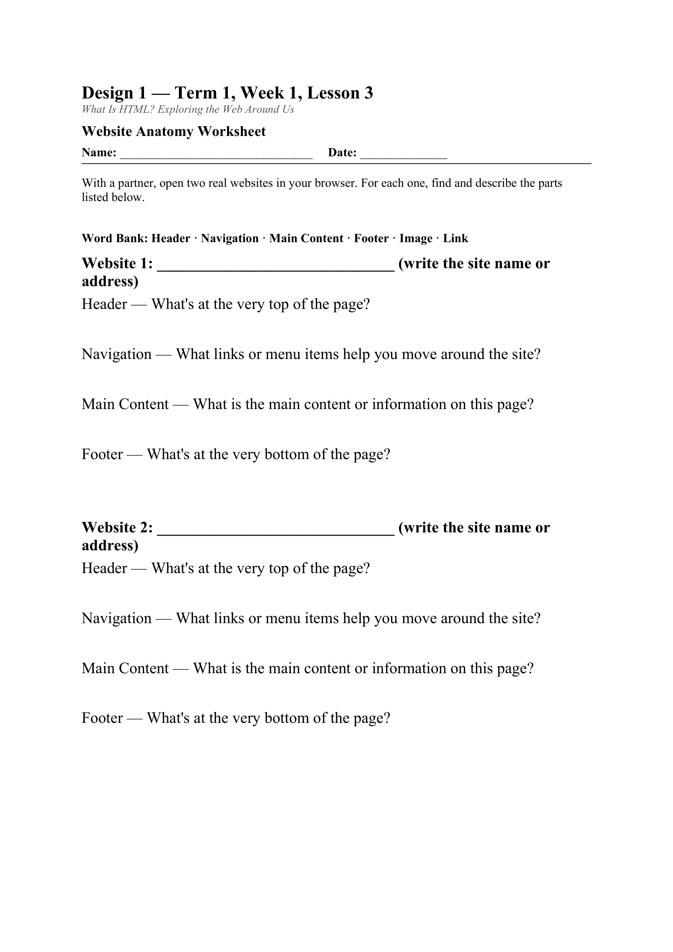
LESSON CORE
Analyzing a Website, 3 Times
Read 1: What is this website about?
Read 2: Find the header, navigation, main content, and footer.
Read 3: Why is it organized this way for its audience?
Gradual Release of Responsibility
30 - 40 minutes
3 / 4
Today's activity: the Website Anatomy Worksheet

Slide 11
LESSON CORE
Connecting to Our Big Question
How can websites be used to solve communication problems and meet user needs?
Gradual Release of Responsibility
30 - 40 minutes
4 / 4

Slide 12
CLOSURE
One sentence: explain the role of HTML in web development.
Transition & Extend
5 - 10 minutes

